Slide 1
Artificial Intelligence-Based Chatbot with Voice Assistance
Balamurugan A
Thiruppathi D
Santhoshkumar S P
Susithra K

Slide 2
ABSTRACT
The widespread use of smartphones and portable devices has led to increased reliance on voice-assisted chatbots like Alexa, Siri, and Google Assistant, which simplify day-to-day tasks for users.
As AI-based chatbots such as ChatGPT, Bard, and Microsoft Bing become more prevalent in handling complex tasks, there is a growing demand for chatbots that combine artificial intelligence with voice assistance capabilities.
To meet this demand, we developed a web application integrating an AI-based large language model using GPT-3.5 and voice assistance.This application converts audio input to text, processes queries using the GPT-3.5 model, and converts the responses back into audio clips, offering a seamless user experience.

Slide 3
INTRODUCTION
Chatbot systems with voice assistance utilize NLP and speech recognition technologies to interpret spoken user queries, enhancing accessibility and user experience.
Integration with cloud-based services such as Google Cloud Speech-to-Text enables efficient conversion of speech input into text format, facilitating seamless interaction with the chatbot's NLP engine.
Through the application of algorithms, the chatbot analyzes the text to discern user intent, generating tailored responses that are conveyed back to the user through text-to-speech technology, fostering effective communication.

Slide 4
EXISTING SYSTEM
Existing chatbot systems with voice assistance utilize a combination of natural language processing (NLP) and speech recognition technologies to interpret user queries spoken aloud.
These systems typically employ cloud-based services or APIs for speech-to-text conversion and NLP processing.
Once the user's query is processed, the chatbot generates a response, which can be presented in both text and audio formats.

Slide 5
DRAWBACKS IN EXISTING SYSTEM
One notable drawback of existing chatbot systems with voice assistance is their reliance on external APIs or cloud-based services, which may introduce latency and privacy concerns. Additionally, the accuracy and effectiveness of these systems may vary depending on the quality of the speech recognition and NLP algorithms employed.

Slide 6
PROPOSED SYSTEM
Our proposed system addresses these limitations by integrating an AI model based on OpenAI's GPT-3.5 directly into the web application, eliminating the need for external APIs.
This allows for faster response times and enhanced privacy, as user data does not need to be transmitted to third-party servers for processing.
The system also includes voice recognition and synthesis modules, enabling seamless interaction with the chatbot using both speech and text inputs and outputs.

Slide 7
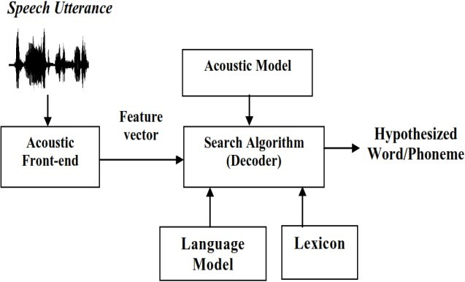
SPEECH

Slide 8
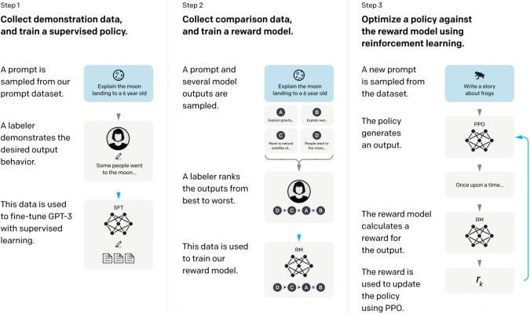
GTP 3.5-ARCHITECTURE

Slide 9
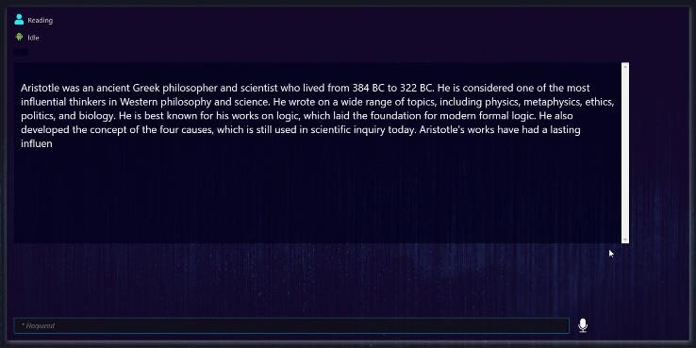
OUTPUT

Slide 10
REFERENCE
T. Ammari,J. Kaye, J. Y. Tsai, and F. Bentley. “Music, Search, and IoT: How people (really) use voice assistants,” ACM Trans. Comput.- Hum. Interact., vol. 26.3, pp. 1-28, 2019.
Sharif K, Tenbergen B. Smart home voice assistants: a literature survey of user privacy and security vulnerabilities. Complex Syst Inform Model Quart. 2020;24:15–30.
Anirudh Khanna, Bishwajeet Pandey, KushagraVashishta, Kartik Kalia, “A study of Today’s A.I through chatbots and Rediscovery of Machine Intelligence”, International Journal of u- and e- Service, Science and Technology, vol.8, No.7,2015.

Slide 11
REFERENCE
M. Lawanya Shri, E. Ganga Devi, Balamurugan Balusamy, and Jyotir Moy Chatterjee, Ontology based information retrieval and matching in IoT applications, Apple academic press and CRC press, Hard ISBN: 9781771888646.
Isewon, O. Oyelade, and O. Oladipupo, “Design and implementation of text to speech conversion for visually impaired people,” International Journal of Applied Information Systems, vol. 7, no. 2, pp. 26–30, 2012.
H. Zen, K. Tokuda, and A. W. Black, “Statistical parametric speech synthesis,” Speech Communication, vol. 51, no. 11, pp.

Slide 12
THANK YOU

